Slide 1
Autopsy and
iPhone Forensics
Cybersecurity
Lesson 21.3

Slide 2

Learning Objectives
By the end of today’s lesson, you will be able to:
1
Identify the methods used in smartphone forensics investigations.
2
Navigate the database and file structure of the iPhone's flash drive.
3
Locate identifiable evidence on the iPhone in order to establish ownership.
4
Use Autopsy to view and tag evidence in an iPhone image.
5
Extract image content for offline viewing in other applications (logs, text, pictures, video, audio).

Slide 5

Recap
In the last lesson, we covered:
01
Basic principles of digital forensics methodologies.
02
Various skill sets required for a career in digital forensics.
03
Proper approach to collecting, preserving, analyzing, and reporting digital forensics evidence.
04
How to conduct a preliminary review for a digital forensics case.
05
How to preserve and document evidence using Autopsy.

Slide 6
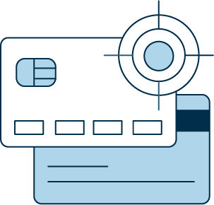
Overview
Today we will focus on smartphone forensics
and continue the Pure Gold Credit Union case
by using Autopsy to view and tag evidence on an iPhone image.
Notes:
shutterstock_167974337

Slide 7

Overview
You will also learn how to perform image searches without using the directory tree.
Instead, you will use:
File Search by Attributes and Keyword Search
Displaying
text and
file metadata

Slide 8

File Systems and Data Storage
Where’s the data?

Slide 9
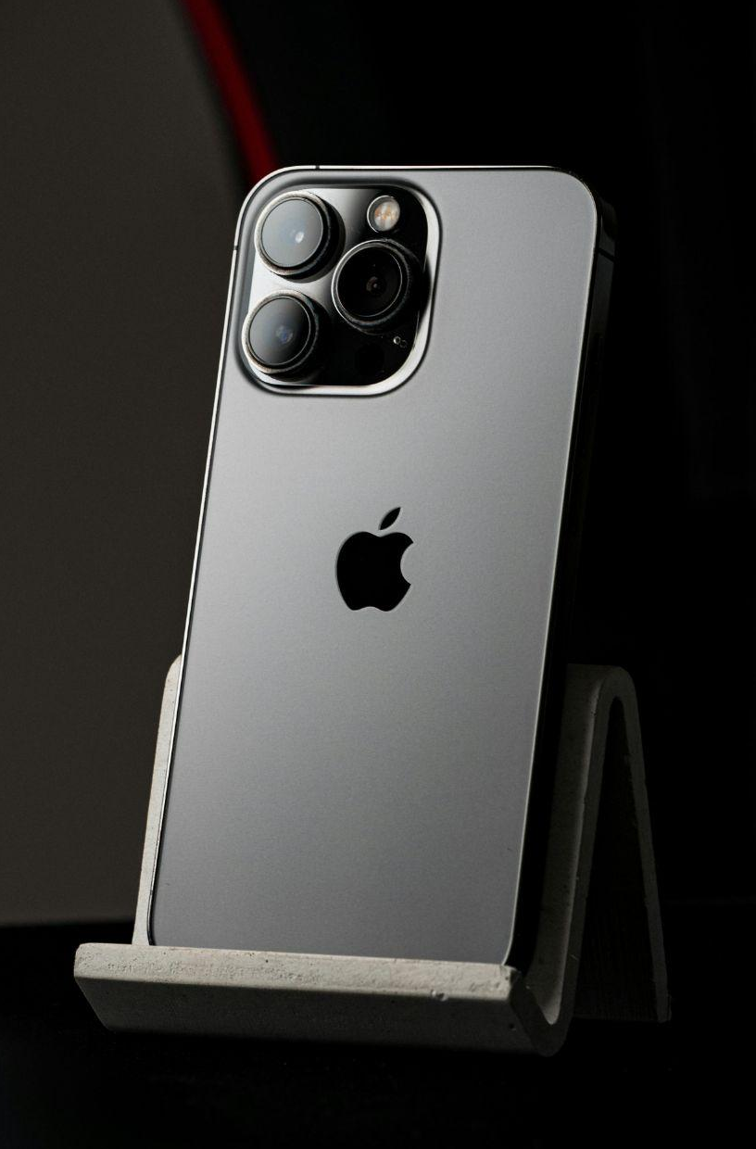
File Systems and Data Storage
Where’s the data?
An iPhone does not have external storage.
All data is stored in flash memory on the device.
Remember
Flash memory retains data without any external power and is used in SSDs and smartphones.
Flash memory on an iPhone exists until
it is overwritten.
Notes:
https://www.pexels.com/photo/iphone-on-display-14168781/

Slide 10

File Systems and Data Storage
An iPhone’s flash memory drive contains two disk partitions:
root
var
The root partition is used for the operating system and applications.
The var partition is used for user data.

Slide 11

Data is first imaged using a bit-level copy.
In an iPhone, this will recover deleted messages as well as GPS coordinates and cell tower locations.
iPhones allow users to back up their data to the cloud, which can be another source of data in an investigation, especially when the device is not available.
Notes:
shutterstock_1060516115

Slide 12
What challenges
does iCloud data
present to a digital forensics investigator?

Slide 13
Answer
Isolating and securing evidence is challenging when data is in multiple locations. Also, Service Level Agreements (SLAs) must be recognized when dealing with other companies, in addition to other legal issues.

Slide 14


Important Directories, Databases, and Files
The following directories are worth investigating for evidence:
/mobile
/Applications
Since iPhone’s iOS is based on Unix,
the directory structure should be familiar.
/Library
Most information is in a human-readable format within the Autopsy application.
/root
/Logs
/logs
Notes:
shutterstock_219776725

Slide 15
The iPhone stores user data in SQL databases and other files.

Slide 16
SQL stands for Structured Query Language and is a language used to create, read, update, and delete (often abbreviated to CRUD) database files.

Slide 17
Important Directories, Databases, and Files
AddressBook.sqlitedb | Contact information and personal data like a person’s name, email address, etc.
AddressBookImages.sqlitedb | Images associated with saved contacts
Calendar.sqlitedb | Calendar details and events information
CallHistory.db | Call logs including phone numbers and timestamps
sms.db | Text and multimedia messages along with timestamps
voicemail.db | Voicemail messages
Safari/Bookmarks | Saved URL addresses
locationd | Google coordinates of locations

Slide 18
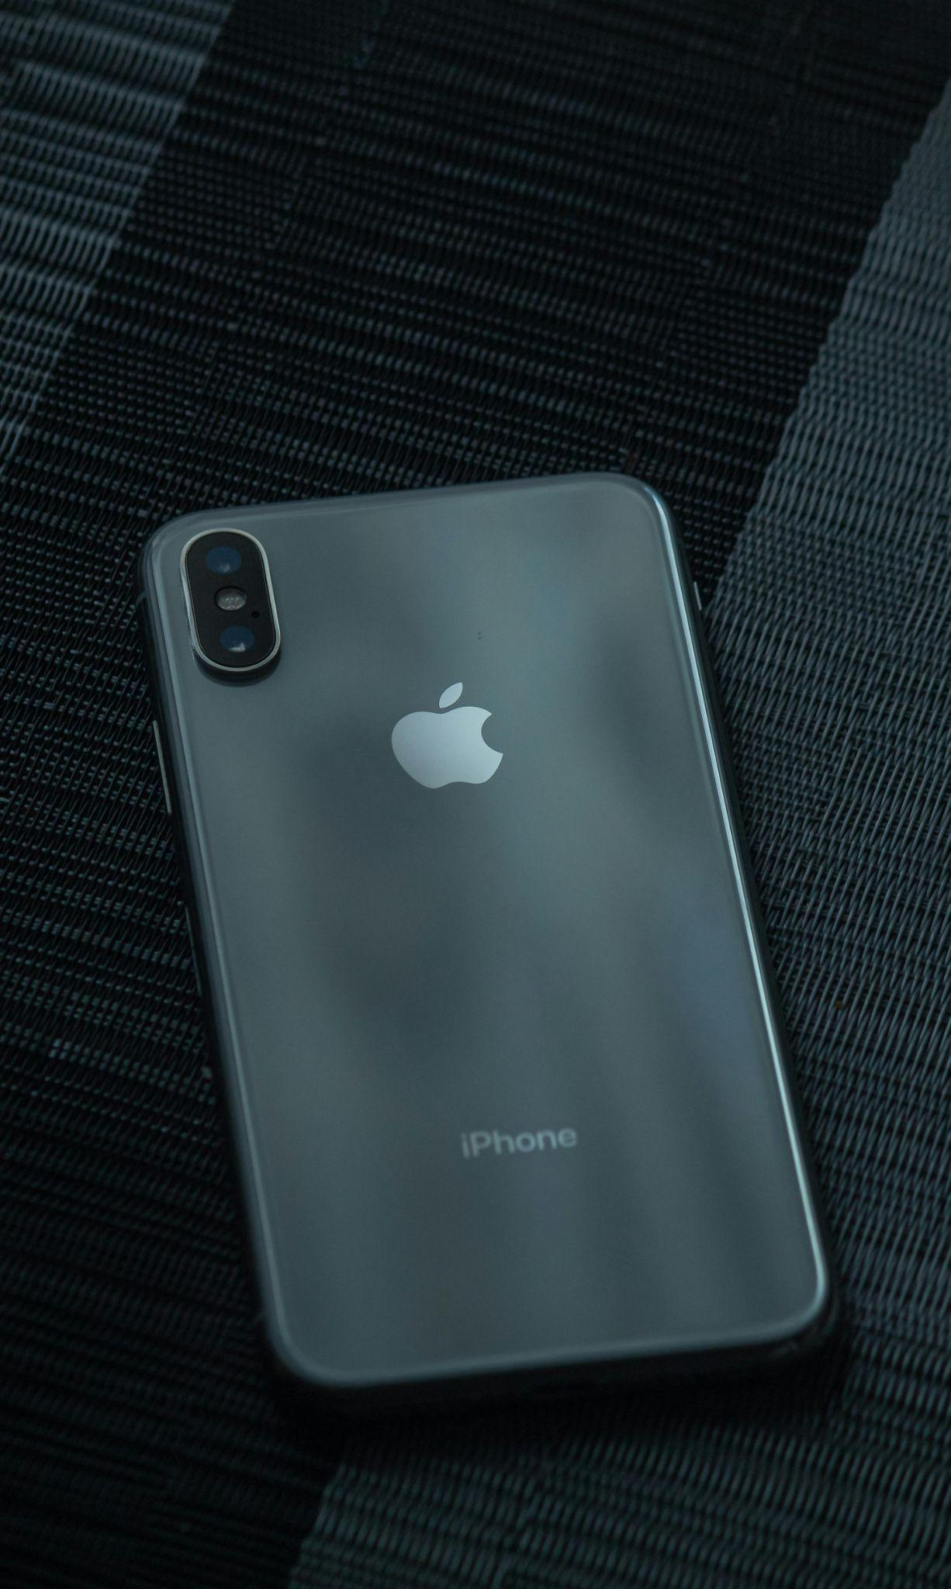
Important Directories, Databases, and Files
iPhone also has data stored in property lists (plists).
activation_record.plist
Contains phone model information including ICCID, IMEI, and serial number.
data_ark.plist
File associated with backup and restore. Contains an assortment of information
including host name and OS version.
Notes:
https://www.pexels.com/photo/close-up-shot-of-a-smartphone-9867097/
https://www.shutterstock.com/image-photo/bangkok-thailand-june-16-2024-iphone-2476280009

Slide 19


Demonstration Scenario
In this demonstration, we will go through various ways to obtain evidence.
File metadata
File searches
Examine browsing history
Displayable text
Notes:
shutterstock_1888488028

Slide 20
Evidence analysis with Autopsy

Slide 22
Mobile evidence analysis
In this activity, you will play the role of a digital forensics investigator.
You are tasked with analyzing evidence and creating a spreadsheet that profiles the details of Peter’s iPhone.
This will serve as your preliminary documentation for the remaining activities.
50 minutes

Slide 26

Evidence Tagging

Slide 27
Evidence tagging is the process of bookmarking digital evidence to keep critical details organized and easily accessible.

Slide 28
We’ll be tagging evidence throughout our investigation to help categorize and organize all digital evidence pertinent to the Pure Gold Credit Union case.

Slide 29
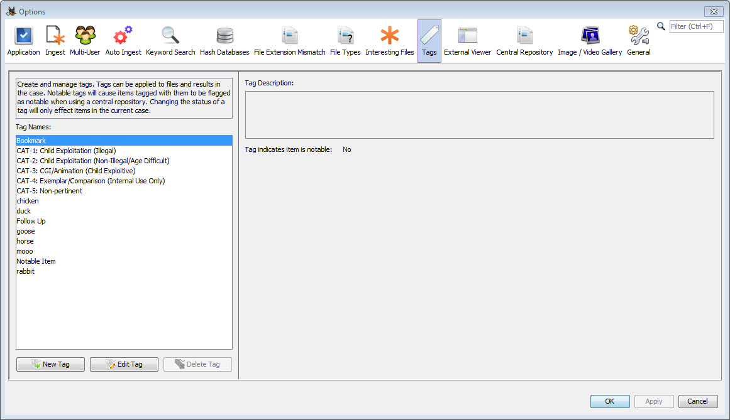
Tagging Evidence
Autopsy includes a built-in feature to tag evidence that contains a set of predefined tags including:
1
Follow Up
2
Notable Item
3
Child Exploitation
4
Uncategorized
5
Non-Pertinent
Source: sleuthkit.org

Slide 30
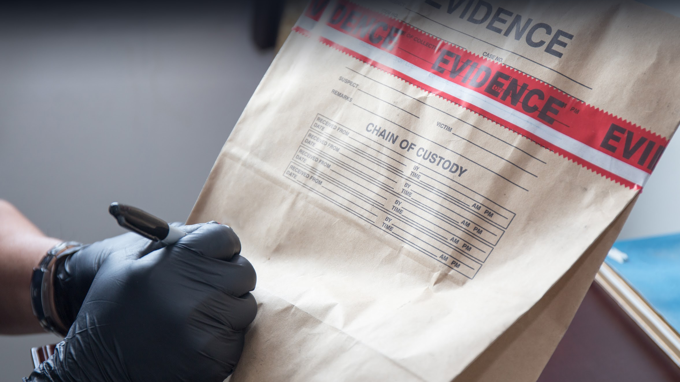
Creating Forensic Backups
Custom tags can also
be created and added
to the Tag database.
Notes:
shutterstock_431385100

Slide 31
Evidence tagging

Slide 32
Evidence tagging
In this activity, you will tag the major databases and files in the iPhone image file.
You will create new tags for evidence that is relevant to the case, such as mail, address book, and SMS.
Be sure to tag as much relevant information as possible. It will be used in later activities as you build your case.
15 minutes

Slide 35

Extracting Data for
Offline Analysis

Slide 36
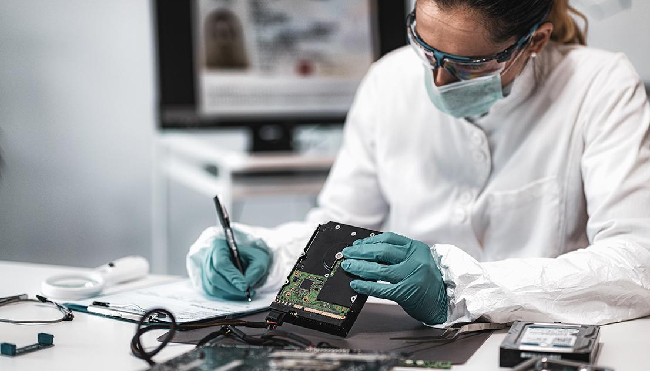
Sometimes investigators use other applications for further offline analysis.
01
Not all data types can be rendered in Autopsy.
Other tools can analyze video, photo,
and audio files in more depth.
02
03
Database information can easily be transferred to spreadsheets or Word documents where it can be manipulated into reports.
Notes:
shutterstock_1508063498

Slide 37
Offline viewing refers to the process of viewing files outside of the main program—in this case, Autopsy.

Slide 38


In the following guided tour,
we’ll extract files and directories for offline viewing.
‹#›
Notes:
Shutterstock_535531051

Slide 39
Single file export

Slide 40
Extracting data for offline analysis
In this activity, you will continue in your role as a digital forensics investigator working on the Pure Gold Credit Union case.
Your task is to create export files for offline examination.
20 minutes

Slide 44
Digital forensics
01
As a digital forensics investigator, you will work as part of a team
that consists of a large collaborative effort.
02
It's critical, as a digital forensics investigator, to understand how
to use tools such as Autopsy and how to export data so that other team members can perform offline analysis of evidence.
03
Tagging evidence helps categorize and label evidence that has already been screened.
04
This eliminates double work and helps other investigative team members continue your work if you become unavailable.

Slide 45
We will continue our investigation by analyzing
email messages, SMS messages, and web history.

